Slide 1

Sales Performance Analysis of Walmart Stores Using Advanced MySQL Techniques
- Sameer N. Phalak

Slide 2
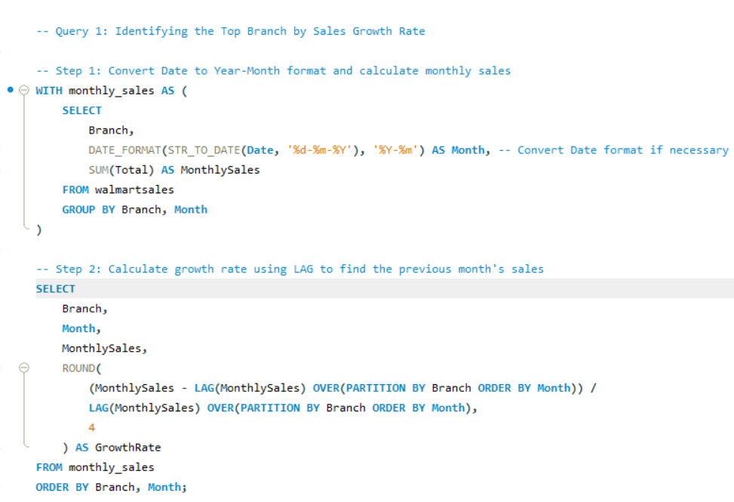
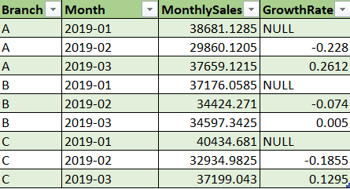
Task 1: Identifying the Top Branch by Sales Growth Rate
Objective : Calculate the monthly sales growth for each branch and identify the branch with the highest growth.

Slide 3
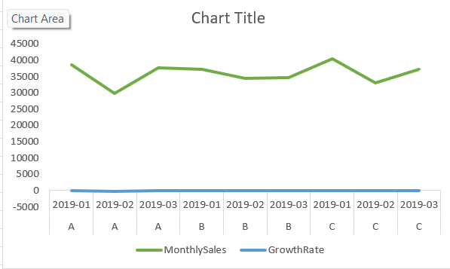
Insights And Recommendation
Insights: By calculating the month-over-month growth rate, we can identify which branch is growing fastest, which may indicate effective management or higher customer engagement.
Branch A’s consistent month-over-month growth may suggest strong management or successful local promotions. Conversely, a branch with stagnant or declining growth (e.g., Branch C) could indicate operational challenges or a need for targeted marketing efforts.
Recommendation: Investigate the specific factors driving growth in the top-performing branch, such as local events, promotions, or management practices. Implement these strategies in other branches to replicate success.

Slide 4
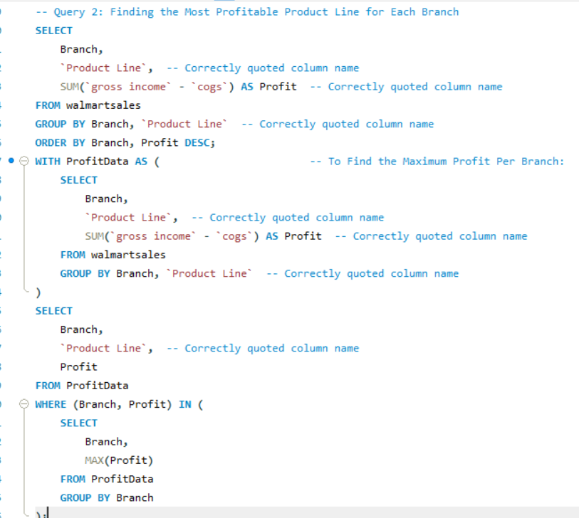
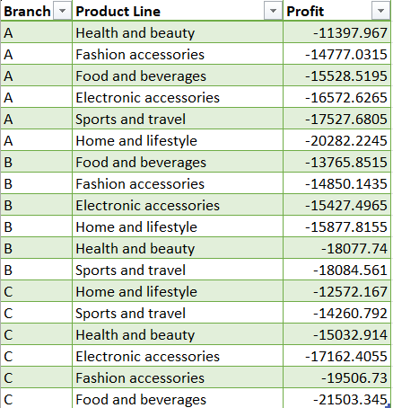

Task 2: Finding the Most Profitable Product Line for Each Branch
Objective : Identify the product line with the highest profit for each branch

Slide 5
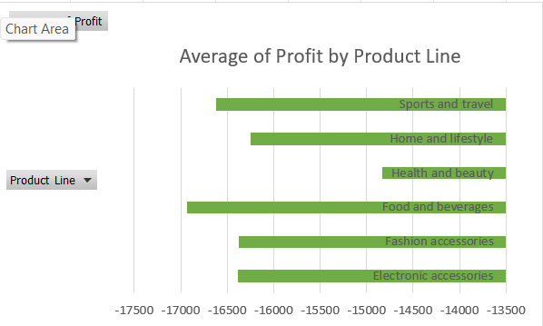
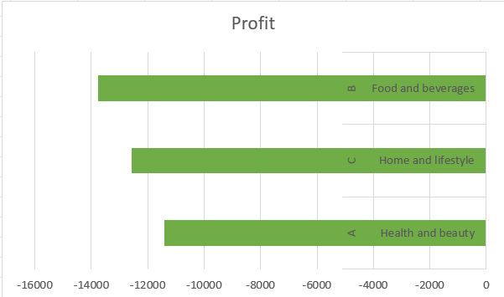
Insights And Recommendation
Insights: For each branch, one product line might stand out as the most profitable. This insight helps Walmart focus on promoting high-margin products in each location.
If a particular product line, such as Electronics, generates high profit across branches, it may indicate high customer demand and margin potential. Low-profit lines in specific branches could suggest either pricing issues or low customer interest in those categories.
Recommendation: Focus on promoting the top product line (e.g., Electronics) to increase overall profit. For lower-performing lines, Walmart could assess whether adjustments to pricing or product variety might increase profitability.

Slide 6
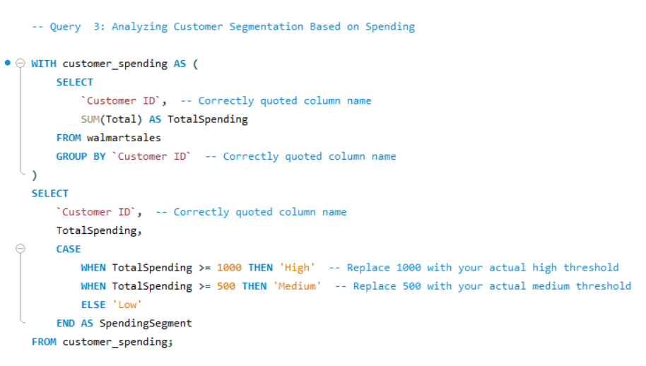
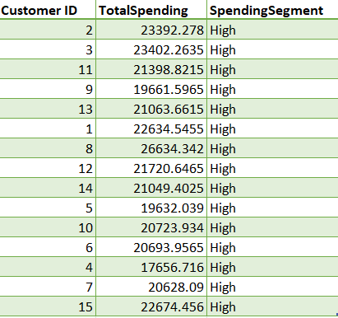
Task 3: Analyzing Customer Segmentation Based on Spending
Objective : Segment customers into "High," "Medium," and "Low" spenders.

Slide 7
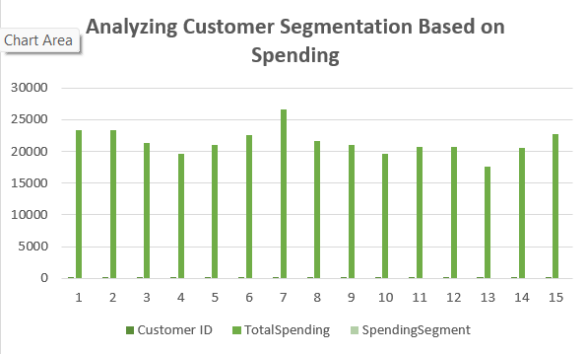
Insights And Recommendation
Insight: This segmentation helps Walmart target marketing strategies based on spending behavior, allowing them to focus premium services or offers on high spenders.
High spenders likely represent loyal, high-value customers who might be interested in premium services, exclusive offers, or membership programs. Medium spenders could be converted to high spenders through targeted incentives, while low spenders may benefit from loyalty-building initiatives.
Recommendation: Create tailored marketing strategies for each segment, such as exclusive discounts for high spenders or loyalty points for low spenders to encourage repeat purchases.

Slide 8
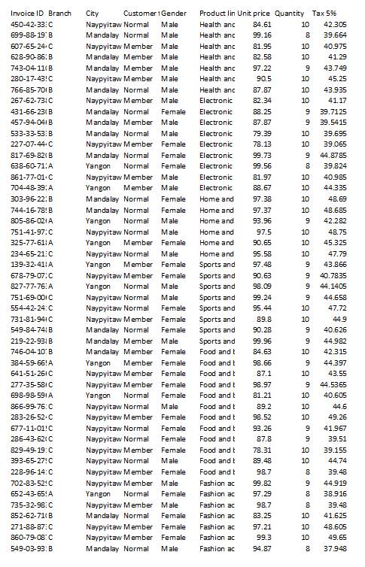
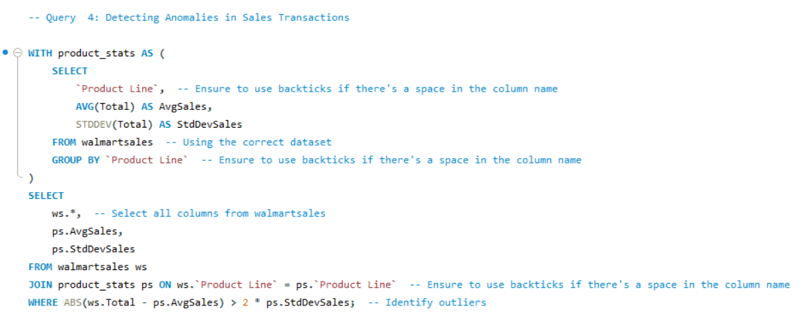
Task 4: Detecting Anomalies in Sales Transactions
Objective: Identify transactions that significantly deviate from average sales values within each product line.

Slide 9
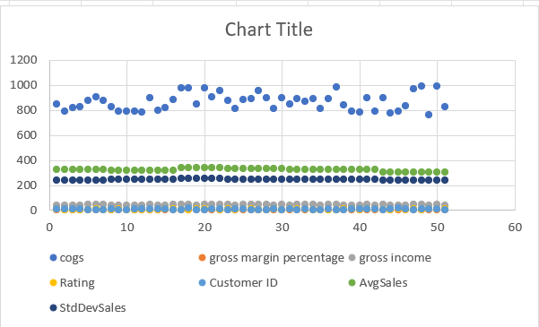
Insights And Recommendation
Insight: Anomalies might indicate unusual purchases or potential errors, helping Walmart improve data accuracy and detect potential fraud.
High outlier transactions may represent bulk purchases or possible fraudulent activity. Low outliers might be promotional items or products frequently discounted, which could impact profit margins if not properly managed.
Recommendation: Review high outliers to ensure no fraudulent transactions are inflating sales, and assess if low outliers are connected to products that need price adjustments or improved profit margins.

Slide 10
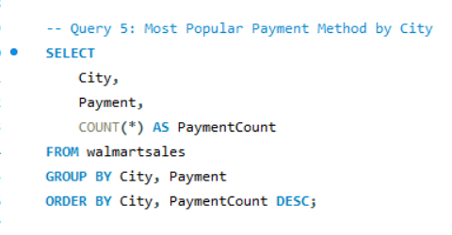
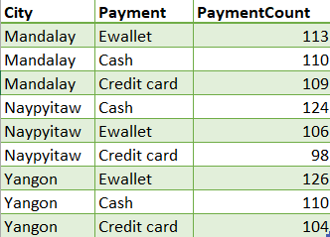
Task 5: Most Popular Payment Method by City
Objective: Determine the preferred payment method in each city.

Slide 11
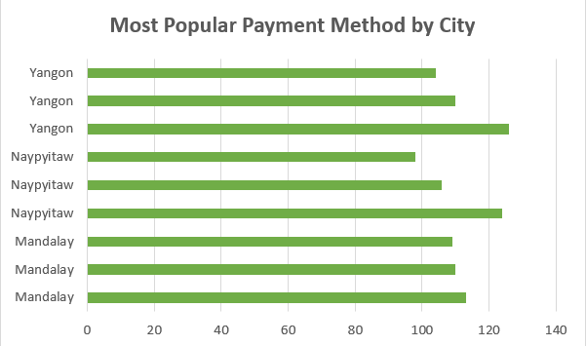
Insights And Recommendation
Insight: Understanding payment preferences helps Walmart in tailoring payment options and promotional offers for each location.
Payment preference variations across cities may indicate local economic factors or customer demographics. A city favoring cash could mean customers are less likely to adopt digital payment methods, impacting how Walmart markets mobile or online payments.
Recommendation: Tailor marketing strategies to payment preferences; for instance, offer cash discounts in cities where Cash is preferred and Ewallet rewards where digital payments are dominant.

Slide 12
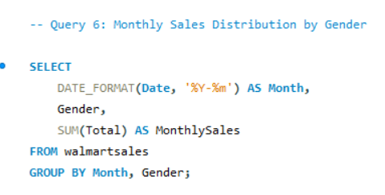

Task 6: Monthly Sales Distribution by Gender
objective: Calculate monthly sales totals by gender.

Slide 13
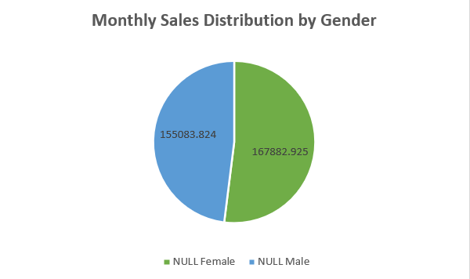
Insights And Recommendation
Insight: This helps Walmart understand demographic purchasing trends, which can inform inventory and advertising strategies.
If male or female customers consistently account for a larger share of sales, this could reflect demographic trends or product line preferences within gender segments. Monthly trends may also reveal seasonal variations that align with events or holidays popular with a specific gender.
Recommendation: Align marketing campaigns with monthly trends; for instance, target promotional campaigns toward the dominant gender during high-sales months.

Slide 14
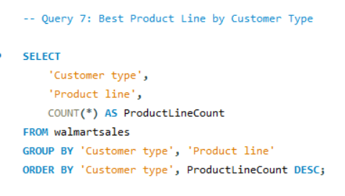

Task 7: Best Product Line by Customer Type
Objective: Find the most popular product line by customer type.

Slide 15
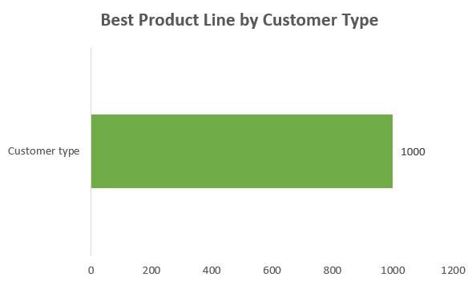
Insights And Recommendation
Insight: This insight helps Walmart understand purchasing behavior based on customer loyalty status and tailor promotions for members versus regular customers.
Differences in product line preferences between Members and Normal customers may indicate that Members favor higher-end or specialized products, while Normal customers might focus on general-use or lower-cost items.
Recommendation: Offer personalized promotions for Members on high-preference items like Electronics, while targeting Normal customers with discounts or bundled deals on their favored lines to increase basket size.

Slide 16
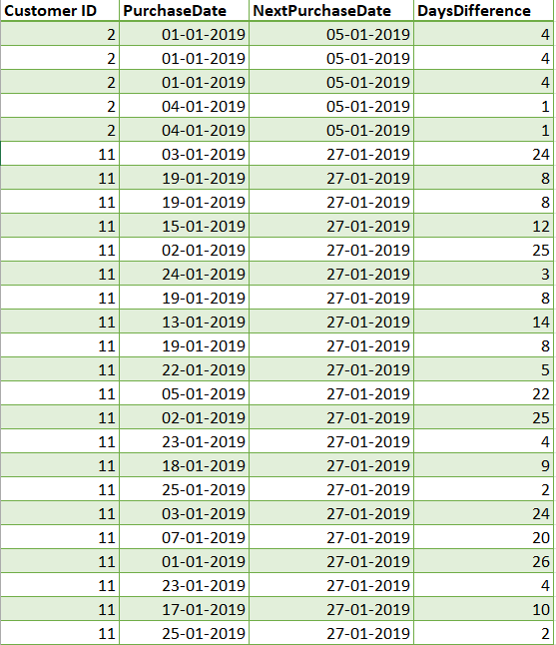
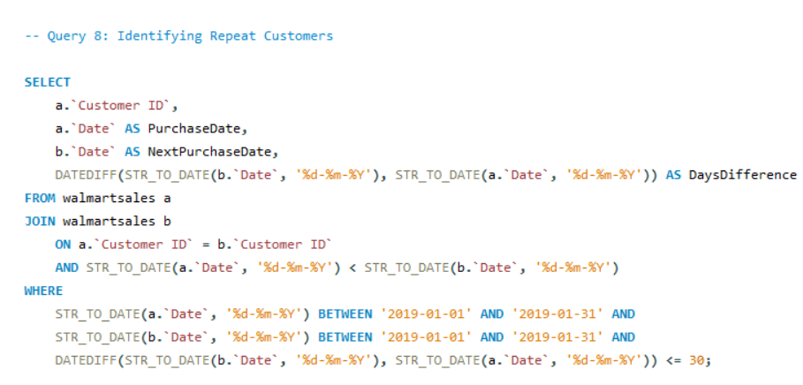
Task 8: Identifying Repeat Customers
Objective: Identify customers with multiple purchases within 30 days.

Slide 17
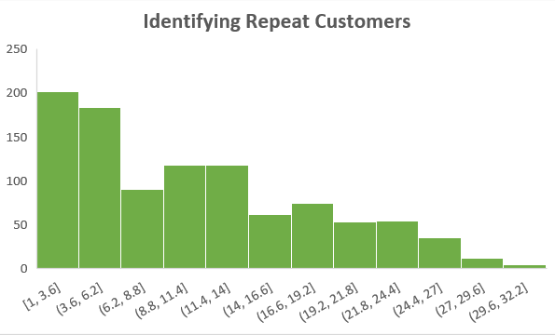
Insights And Recommendation
Insight: Understanding repeat customers helps Walmart reward loyalty and design targeted offers to retain frequent shoppers.
High repeat customer rates indicate strong loyalty, particularly within a short time frame. Identifying peak periods for repeat visits (e.g., within a week versus a month) can help Walmart understand customer shopping cycles and plan targeted promotions.
Recommendation: Offer time-sensitive incentives, like a 10% discount if a customer returns within 30 days, to boost repeat purchase rates.

Slide 18
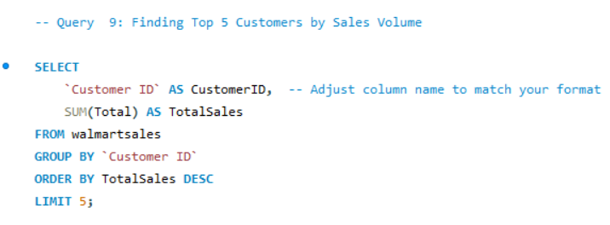
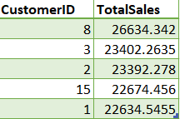
Task 9: Finding Top 5 Customers by Sales Volume
Objective: Identify the top 5 customers by total sales.

Slide 19
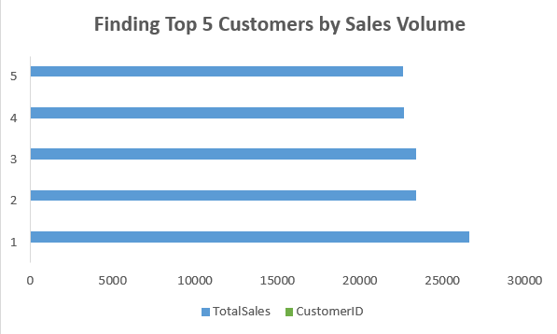
Insights And Recommendation
Insight: This helps Walmart recognize high-value customers and potentially offer them special incentives or loyalty rewards.
The top customers’ spending patterns can reveal their preferred product lines, frequency of purchases, and average basket size, offering valuable information for targeted loyalty programs or exclusive incentives.
Recommendation: Recognize top spenders with rewards, such as membership perks, or offer them early access to sales events. This can improve customer retention and lifetime value.

Slide 20
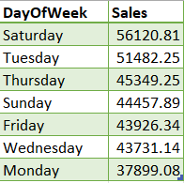
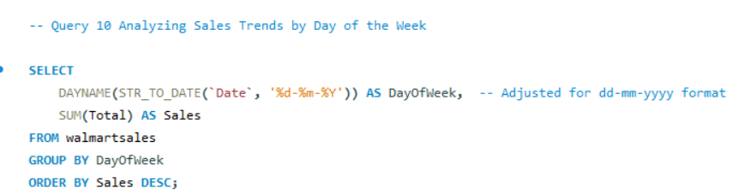
Task 10: Analyzing Sales Trends by Day of the Week
Objective: Determine the busiest day for sales.

Slide 21
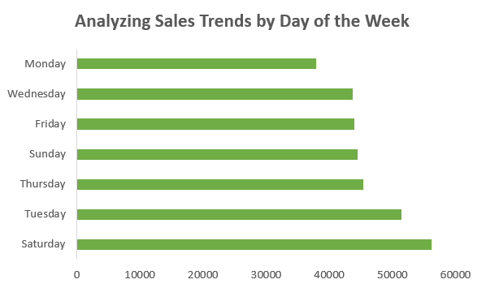
Insights And Recommendation
Insight: This helps Walmart optimize staffing, promotions, and inventory management around peak days.
Peak sales days (e.g., weekends) often indicate when customers are most available to shop, which can help Walmart optimize staffing, inventory, and promotional events.
Recommendation: Schedule key promotions or discounts for the days with the highest foot traffic and consider adjusting store hours to match peak demand.

Slide 22
Summary and Key Takeaways
To summarize, this analysis provided Walmart with several actionable insights:
Branch A is leading in growth, and Electronics is the top profit driver in certain branches.
Customer segments and payment preferences vary by location, offering a chance to personalize Walmart’s approach.
Target high spenders and recognizing repeat customers can boost loyalty and revenue.
Final Recommendations: Walmart can enhance its overall strategy by focusing on high-growth branches, tailoring promotions by customer type, and aligning inventory and staffing with peak sales times.

Slide 23
Video Explainations
https://drive.google.com/file/d/1roYa7_zypCvBQjgHcfEE9mEOWiU7rfFh/view?usp=sharing

Slide 24
Thank You

